Slide 1
Classification

Slide 2
Classification: Definition
●● Given a collection of records (training set )
●● Each record contains a set of attributes, one of the attributes is the class.
●● Find a model for class attribute as a function of the values of other attributes.
●● Goal: previously unseen records should be assigned a class as accurately as possible.
●● A test set is used to determine the accuracy of the model. Usually, the given data set is divided into training and test sets, with training set used to build the model and test set used to validate it.

Slide 3

Illustrating Classification Task
Tid | Attrib1 | Attrib2 | Attrib3 | Class
1 | Yes | Large | 125K | No
2 | No | Medium | 100K | No
3 | No | Small | 70K | No
4 | Yes | Medium | 120K | No
5 | No | Large | 95K | Yes
6 | No | Medium | 60K | No
7 | Yes | Large | 220K | No
8 | No | Small | 85K | Yes
9 | No | Medium | 75K | No
10 | No | Small | 90K | Yes
Learning algorithm
Induction
Learn Model
10
Training Set
Model
Apply Model
Deduction
Tid | Attrib1 | Attrib2 | Attrib3 | Class
11 | No | Small | 55K | ?
12 | Yes | Medium | 80K | ?
13 | Yes | Large | 110K | ?
14 | No | Small | 95K | ?
15 | No | Large | 67K | ?
10
Test Set

Slide 4



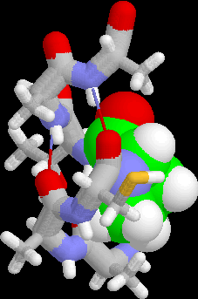
Examples of Classification Task
●● Predicting tumor cells as benign or malignant
●● Classifying credit card transactions as legitimate or fraudulent
●● Classifying secondary structures of protein as alpha-helix, beta-sheet, or random
coil
●● Categorizing news stories as finance, weather, entertainment, sports, etc

Slide 5
Classification Techniques
●● Decision Tree based Methods
●● Rule-based Methods
●● Memory based reasoning
●● Neural Networks
●● Naïve Bayes and Bayesian Belief Networks
●● Support Vector Machines
●● …

Slide 6

Example of a Decision Tree
Splitting Attributes
Tid | Refund | Marital Status | Taxable Income | Cheat
1 | Yes | Single | 125K | No
2 | No | Married | 100K | No
3 | No | Single | 95K | No
4 | Yes | Married | 120K | No
5 | No | Divorced | 70K | Yes
6 | No | Married | 85K | No
7 | Yes | Divorced | 220K | No
8 | No | Single | 60K | Yes
9 | No | Married | 90K | No
10 | No | Single | 75K | Yes
Refund
Yes
No
NO
MarSt
Single, Divorced
Married
TaxInc
NO
>80K
<80K
NO
YES
10
Training Data
Model: Decision Tree
‹#›

Slide 7

Another Example of Decision Tree
MarSt
Single, Divorced
Tid | Refund | Marital Status | Taxable Income | Cheat
1 | Yes | Single | 125K | No
2 | No | Married | 100K | No
3 | No | Single | 70K | No
4 | Yes | Married | 120K | No
5 | No | Divorced | 95K | Yes
6 | No | Married | 60K | No
7 | Yes | Divorced | 220K | No
8 | No | Single | 85K | Yes
9 | No | Married | 75K | No
10 | No | Single | 90K | Yes
Married
NO
Refund
Yes
No
NO
TaxInc
< 80K
> 80K
NO
YES
There could be more than one tree that fits the same data!
10
‹#›

Slide 8
Apply Model to Test Data
Test Data
Start from the root of tree.
Refund | Marital Status | Taxable Income | Cheat
No | Married | 120 | ?
Refund
10
Yes
No
NO
MarSt
Single, Divorced
Married
TaxInc
NO
< 80K
> 80K
NO
YES
‹#›

Slide 9

Decision Tree Classification Task
Tid | Attrib1 | Attrib2 | Attrib3 | Class
1 | Yes | Large | 125K | No
2 | No | Medium | 100K | No
3 | No | Small | 70K | No
4 | Yes | Medium | 120K | No
5 | No | Large | 95K | Yes
6 | No | Medium | 60K | No
7 | Yes | Large | 220K | No
8 | No | Small | 85K | Yes
9 | No | Medium | 75K | No
10 | No | Small | 90K | Yes
Tree Induction algorithm
Induction
Learn Model
10
Training Set
Model
Apply Model
Decision Tree
Tid | Attrib1 | Attrib2 | Attrib3 | Class
11 | No | Small | 55K | ?
12 | Yes | Medium | 80K | ?
13 | Yes | Large | 110K | ?
14 | No | Small | 95K | ?
15 | No | Large | 67K | ?
Deduction
10
Test Set
9

Slide 10
Decision Tree Induction
●● Many Algorithms:
●● H unt,sAlgorithm (one of the earliest)
●● CART
●● ID3, C4.5
●● SLIQ,SPRINT
10

Slide 11
How to Specify Test Condition?
●● Depends on attribute types
●● Nominal
●● Ordinal
●● Continuous
●● Depends on number of ways to split
●● 2-way split
●● Multi-way split

Slide 12
Splitting Based on Ordinal Attributes
●● Multi-way split: Use as many partitions as distinct values.
Size
Small Large
Medium
●● Binary split: Divides values into two subsets.
Need to find optimal partitioning.
Size
OR
Size
{Small, Medium}
{Large}
{Medium, Large}
{Small}

Slide 13
Splitting Based on Continuous Attributes
Taxable Income
> 80K?
Taxable Income?
< 10K
> 80K
Yes
No
[10K,25K)
[25K,50K)
[50K,80K)
(i) Binary split
(ii) Multi-way split

Slide 14
Splitting Based on Continuous Attributes
●● Different ways of handling
●● Discretization to form an ordinal categorical attribute
Static – discretize once at the beginning
Dynamic – ranges can be found by equal interval
bucketing, equal frequency bucketing (percentiles), or clustering.
●● Binary Decision: (A < v) or (A ≥ v)
consider all possible splits and finds the best cut
can be more compute intensive

Slide 15
Decision Tree Based Classification
●● Advantages:
●● Inexpensive to construct
●● Extremely fast at classifying unknown records
●● Easy to interpret for small-sized trees
●● Accuracy is comparable to other classification techniques for many simple data sets
●● Example
●● C4.5
●● Uses Information Gain
●● Needs entire data to fit in memory.

Slide 16
Bayesian Classifiers
●● Approach:
●● compute the posterior probability P(C | A₁, A₂, …, A_{n}) for all values of C using the Bayes theorem
P( A A … A
1 2 n
| C)P(C)
P(C | A A … A ) =
1 2 n
P( A A … A )
1 2 n
●● Choose value of C that maximizes P(C | A₁, A₂, …, A_{n})
●● Equivalent to choosing value of C that maximizes P(A₁, A₂, …, A_{n}|C) P(C)
●● How to estimate P(A₁, A₂, …, A_{n} | C )?

Slide 17
Naïve Bayes Classifier
●● Assume independence among attributes A_{i} when class is given:
●● P(A₁, A₂, …, A_{n} |C) = P(A₁| C_{j}) P(A₂| C_{j})… P(A_{n}| C_{j})
●● Can estimate P(A_{i}| C_{j}) for all A_{i} and C_{j}.
●● New point is classified to C_{j} if P(C_{j}) Π P(A_{i}| C_{j}) is maximal.

Slide 18
Estimating Probabilities: Categorical
●● Class: P(C) = N_{c}/N
●● e.g., P(No) = 7/10,
P(Yes) = 3/10
●● For discrete attributes: P(A_{i} | C_{k}) = |A_{ik}|/ N_{k c}
●● where |A_{ik}| is number of instances having attribute A_{i} and belongs to class C_{k}
●● Examples:
P(Status=Married|No) = 4/7
Tid | Refund | Marital Status | Taxable Income | Evade
1 | Yes | Single | 125K | No
2 | No | Married | 100K | No
3 | No | Single | 70K | No
4 | Yes | Married | 120K | No
5 | No | Divorced | 95K | Yes
6 | No | Married | 60K | No
7 | Yes | Divorced | 220K | No
8 | No | Single | 85K | Yes
9 | No | Married | 75K | No
10 | No | Single | 90K | Yes
10

Slide 19
Example of Naïve Bayes Classifier
Given a test record:
X = (Refund = No,Married,Income = 120K)
naive Bayes Classifier:
P(X|Class=No) = P(Refund=No|Class=No)
P(Married| Class=No)
P(Income=120K| Class=No)
= 4/7 × 4/7 × 0.0072 = 0.0024
P(Refund=Yes|No) = 3/7 P(Refund=No|No) = 4/7 P(Refund=Yes|Yes) = 0
P(Refund=No|Yes) = 1
P(Marital Status=Single|No) = 2/7 P(Marital Status=Divorced|No)=1/7 P(Marital Status=Married|No) = 4/7 P(Marital Status=Single|Yes) = 2/7 P(Marital Status=Divorced|Yes)=1/7 P(Marital Status=Married|Yes) = 0
For taxable income:
If class=No: sample mean=110
sample variance=2975 If class=Yes: sample mean=90
sample variance=25
P(X|Class=Yes) = P(Refund=No| Class=Yes)
P(Married| Class=Yes)
P(Income=120K| Class=Yes)
= 1 × 0 × 1.2 × 10⁻⁹ = 0
Since P(X|No)P(No) > P(X|Yes)P(Yes) Therefore P(No|X) > P(Yes|X)
🡺🡺 Class = No
38

Slide 20
Estimating Probabilities: Continuous
●● Normal distribution:
Tid | Refund | Marital Status | Taxable Income | Evade
1 | Yes | Single | 125K | No
2 | No | Married | 100K | No
3 | No | Single | 70K | No
4 | Yes | Married | 120K | No
5 | No | Divorced | 95K | Yes
6 | No | Married | 60K | No
7 | Yes | Divorced | 220K | No
8 | No | Single | 85K | Yes
9 | No | Married | 75K | No
10 | No | Single | 90K | Yes
1
( A −μ
₎2
−
i ij
P( A | c ) =
i j
e
2
2 σ _{ij}
2πσ
2
ij
●● One for each (A_{i},c_{i}) pair
●● For (Income, Class=No):
●● If Class=No
sample mean = 110
sample variance = 2975
10
1
(120−110 )²
P(Income =
120 | No) =
e
2π (54.54)
−
2 ( 2975 )
= 0.0072

Slide 21
Naïve Bayes Classifier
●● If one of the conditional probability is zero, then the entire expression becomes zero
●● Probability estimation:
N
Original : P( A | C) =
ic
i
N_{c}
c: number of classes p: prior probability m: parameter
N + 1
Laplace : P( A | C) =
ic
i
N_{c} + c
N + mp
m - estimate : P( A | C) =
ic
i
N_{c} + m
39

Slide 22
Example of Naïve Bayes Classifier
Name | Give Birth | Can Fly | Live in Water | Have Legs | Class
human | yes | no | no | yes | mammals
python | no | no | no | no | non-mammals
salmon | no | no | yes | no | non-mammals
whale | yes | no | yes | no | mammals
frog | no | no | sometimes | yes | non-mammals
komodo | no | no | no | yes | non-mammals
bat | yes | yes | no | yes | mammals
pigeon | no | yes | no | yes | non-mammals
cat | yes | no | no | yes | mammals
leopard shark | yes | no | yes | no | non-mammals
turtle | no | no | sometimes | yes | non-mammals
penguin | no | no | sometimes | yes | non-mammals
porcupine | yes | no | no | yes | mammals
eel | no | no | yes | no | non-mammals
salamander | no | no | sometimes | yes | non-mammals
gila monster | no | no | no | yes | non-mammals
platypus | no | no | no | yes | mammals
owl | no | yes | no | yes | non-mammals
dolphin | yes | no | yes | no | mammals
eagle | no | yes | no | yes | non-mammals
A: attributes M: mammals
N: non-mammals
6 6 2 2
P( A | M ) = × × × = 0.06
7 7 7 7
P( A | N ) =
1 10 3 4
× × × = 0.0042
13 13 13 13
P( A | M )P(M ) = 0.06 ×
7
= 0.021
20
P( A | N )P(N ) = 0.004 × ¹³ = 0.0027
20
Give Birth | Can Fly | Live in Water | Have Legs | Class
yes | no | yes | no | ?
P(A|M)P(M) > P(A|N)P(N)
=> Mammals
40

Slide 23
Metrics for Performance Evaluation
●● Focus on the predictive capability of a model
●● Rather than how fast it takes to classify or build models, scalability, etc.
●● Confusion matrix (= Contingency table):
 | PREDICTED CLASS
ACTUAL CLASS |  | Class=Yes | Class=No
 | Class=Yes | a | b
 | Class=No | c | d
a: TP (true positive) b: FN (false negative) c: FP (false positive) d: TN (true negative)

Slide 24
Metrics for Performance Evaluation…
 | PREDICTED CLASS
ACTUAL CLASS |  | Class=Yes | Class=No
 | Class=Yes | a (TP) | b (FN)
 | Class=No | c (FP) | d (TN)
●● Most widely-used metric:
a + d
TP + TN
Accuracy =
=
a + b + c + d
TP + TN + FP + FN

Slide 25
Limitation of Accuracy
●● Consider a 2-class problem
●● Number of Class 0 examples = 9990
●● Number of Class 1 examples = 10
●● If model predicts everything to be class 0, accuracy is 9990/10000 = 99.9 %
●● Accuracy is misleading because model does not detect any class 1 example

Slide 26
Cost-Sensitive Measures
a TP
Precision (p) =
=
a + c TP + FP
a
TP
Recall (r) =
=
a + b TP + FN
F-measure (F) = ^{2rp} =
2a
r + p 2a + b + c
Precision is biased towards C(Yes|Yes) & C(Yes|No)
Recall is biased towards C(Yes|Yes) & C(No|Yes)
F-measure is biased towards all except C(No|No)
44

Slide 27


Eg, WEKA
●● Java based DM tool and library
●● http://www.cs.waikato.ac.nz/ml/weka/

Slide 28

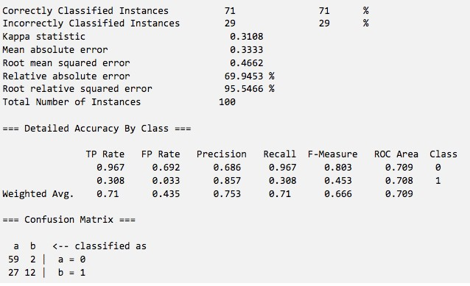
Eg, WEKA Test Run
🡨🡨 Accuracy
59 / (59 + 27) = 0.686
59 / (59 + 2) = 0.967 🡪🡪
Class 0
Class 1
TP=59 | FN=2
TP=12 | FN=27

Slide 29

Case Study for Classification
●● “Private traits and attributes are predictable from digital records of human behavior”
●● By Michal Kosinskia, David Stillwella, and Thore Graepelb
●● PNAS 2018
●● Main findings:
●● Some correlation between Facebook LIKEs and user private traits
o Eg, age, gender, religion, …

Slide 30
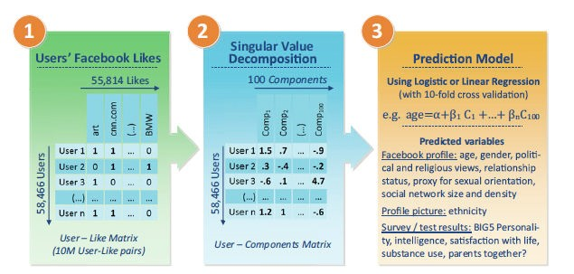
Workflow

